Slide 1
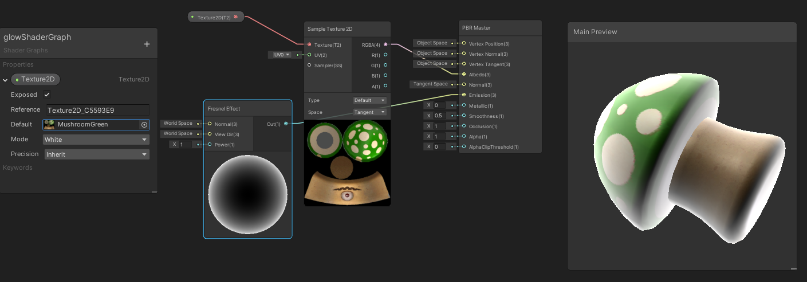

Slide 2
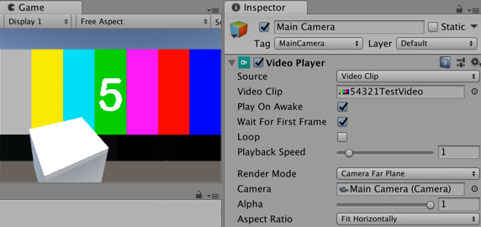
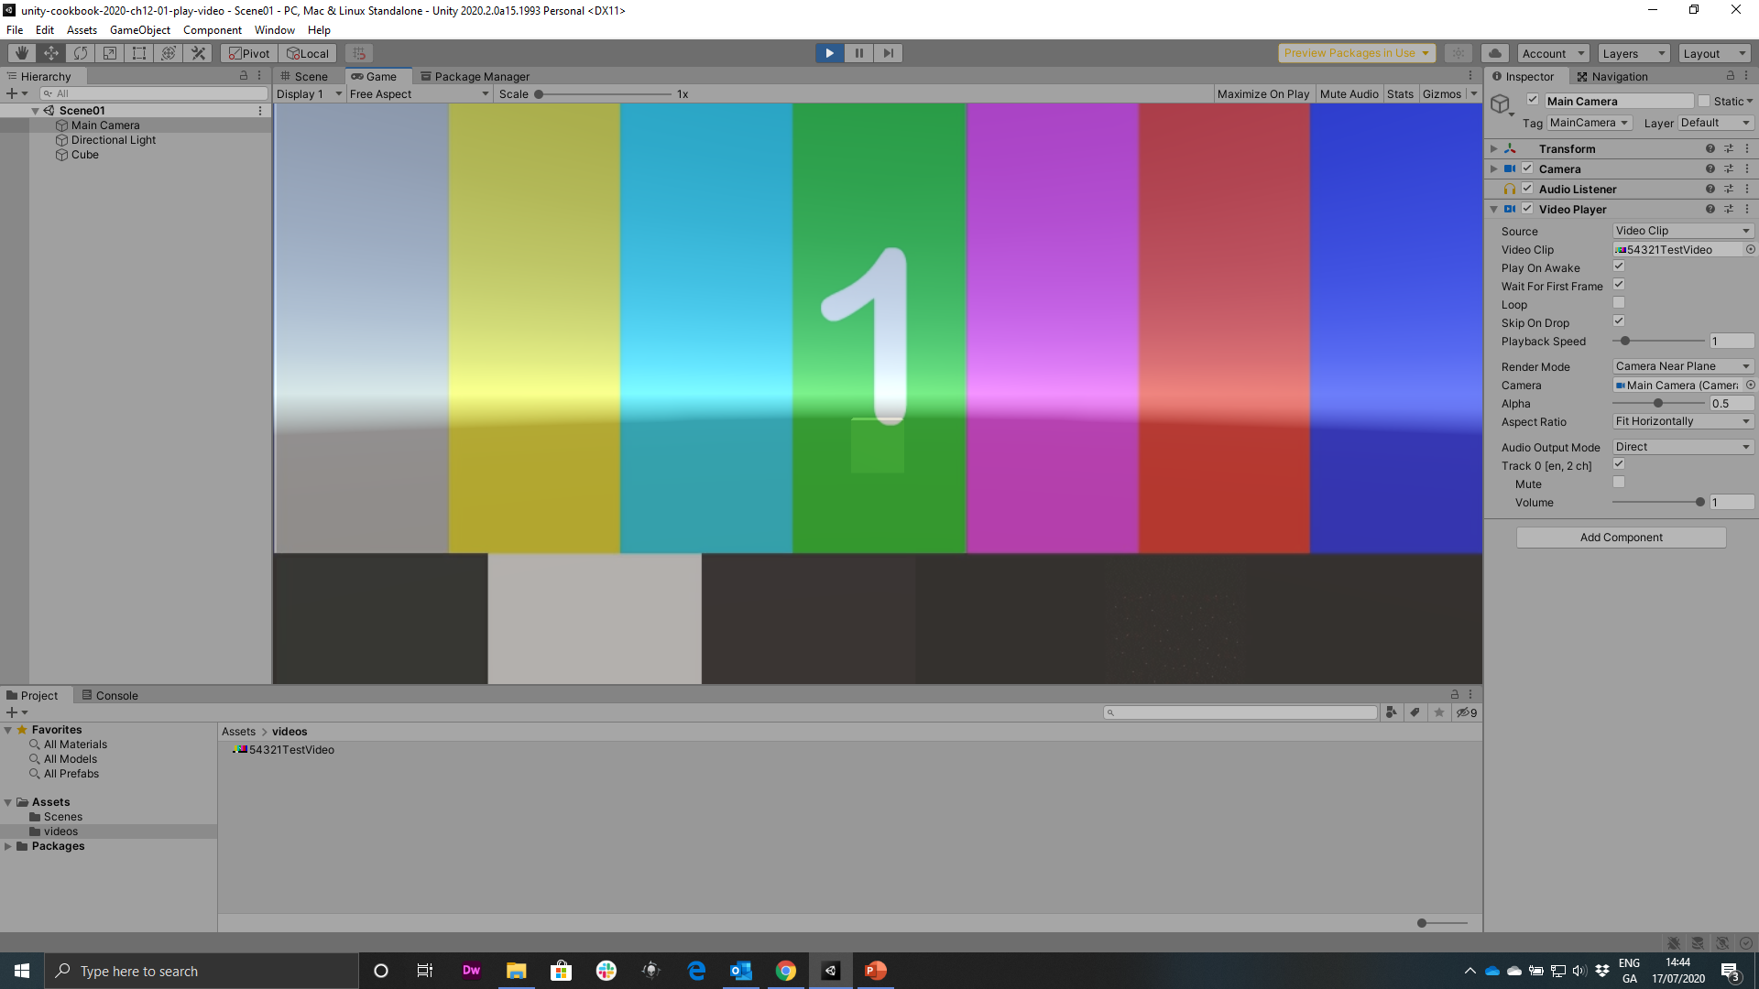
Figure 12.2: Inspector Panel of Main Camera showing the source Video Clip
Choose function-method
SceneLoader.LoadOnClick

Slide 3
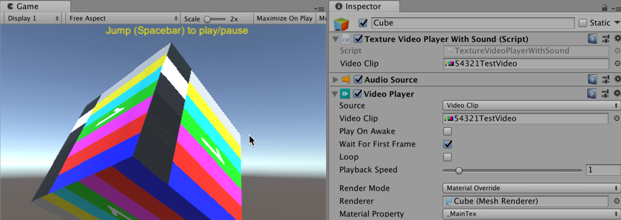
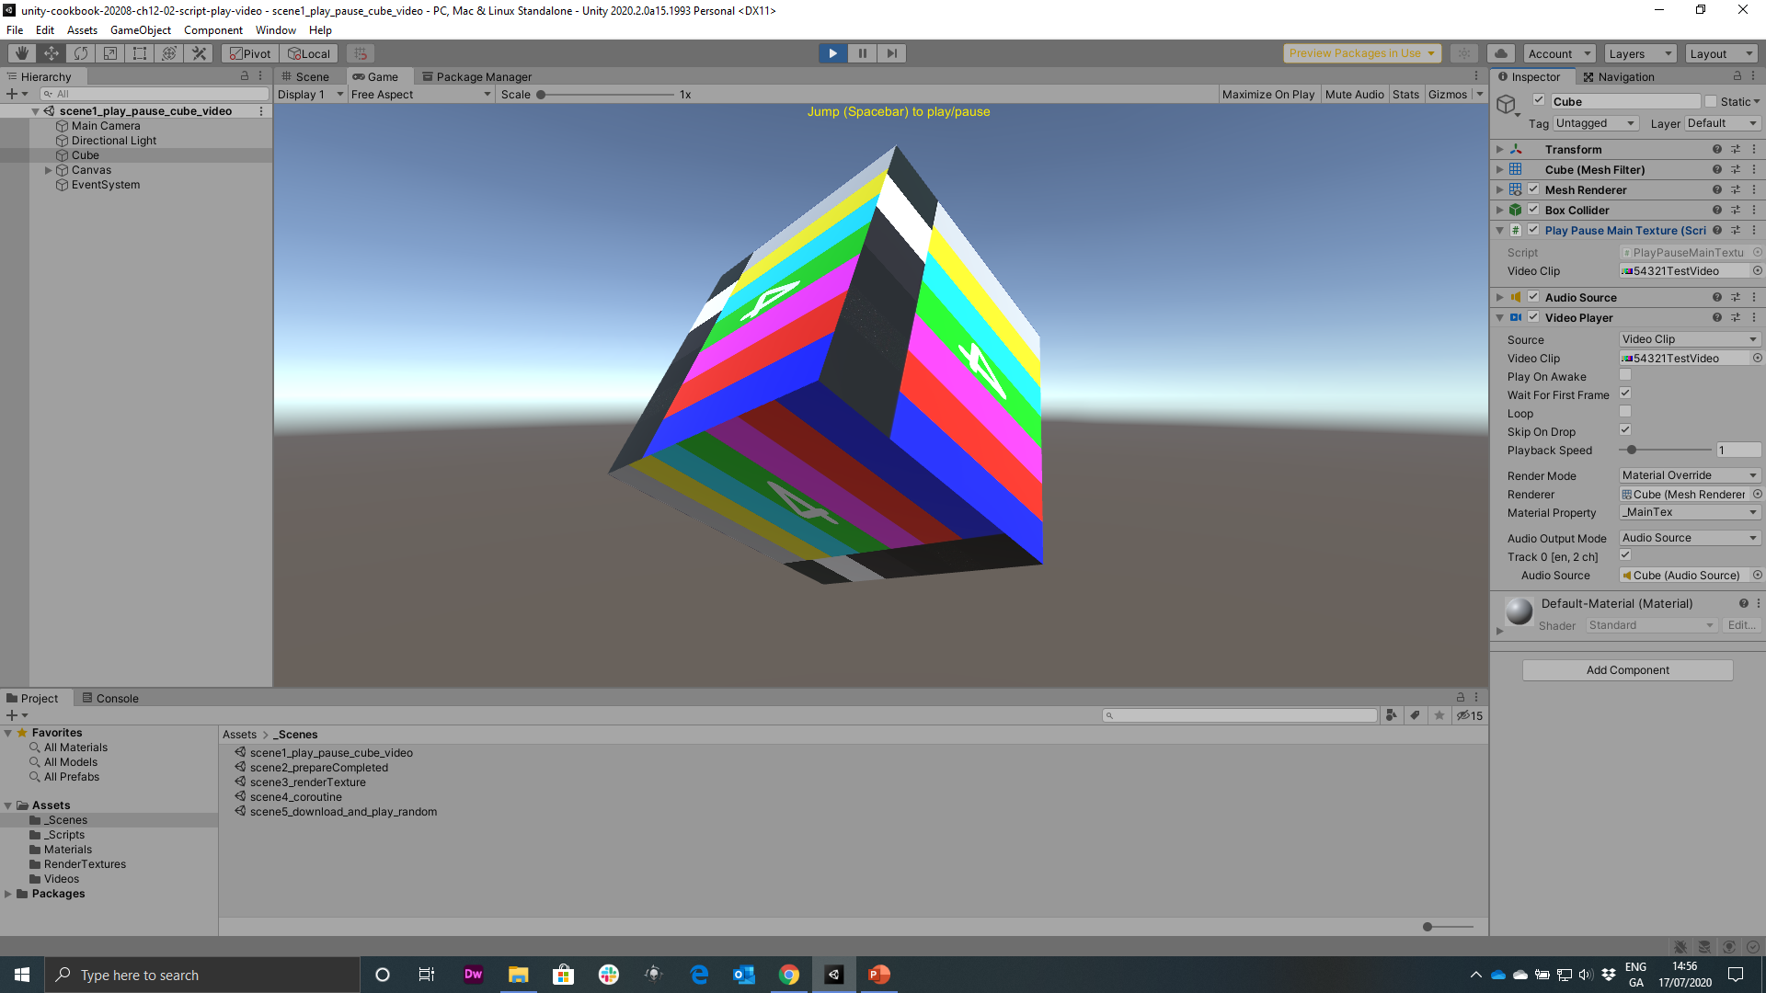
Figure 12.3: Example of a recipe using a script to control the video

Slide 4
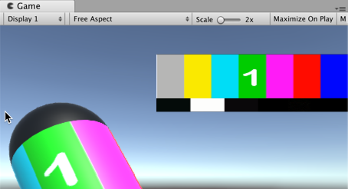
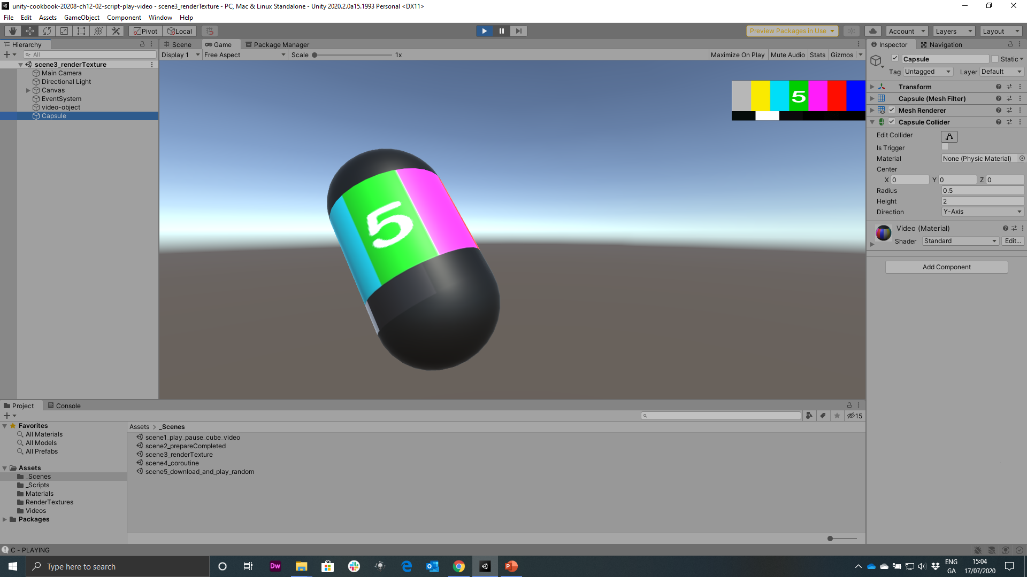
Figure 12.4: example of video rendered on to a capsule

Slide 5
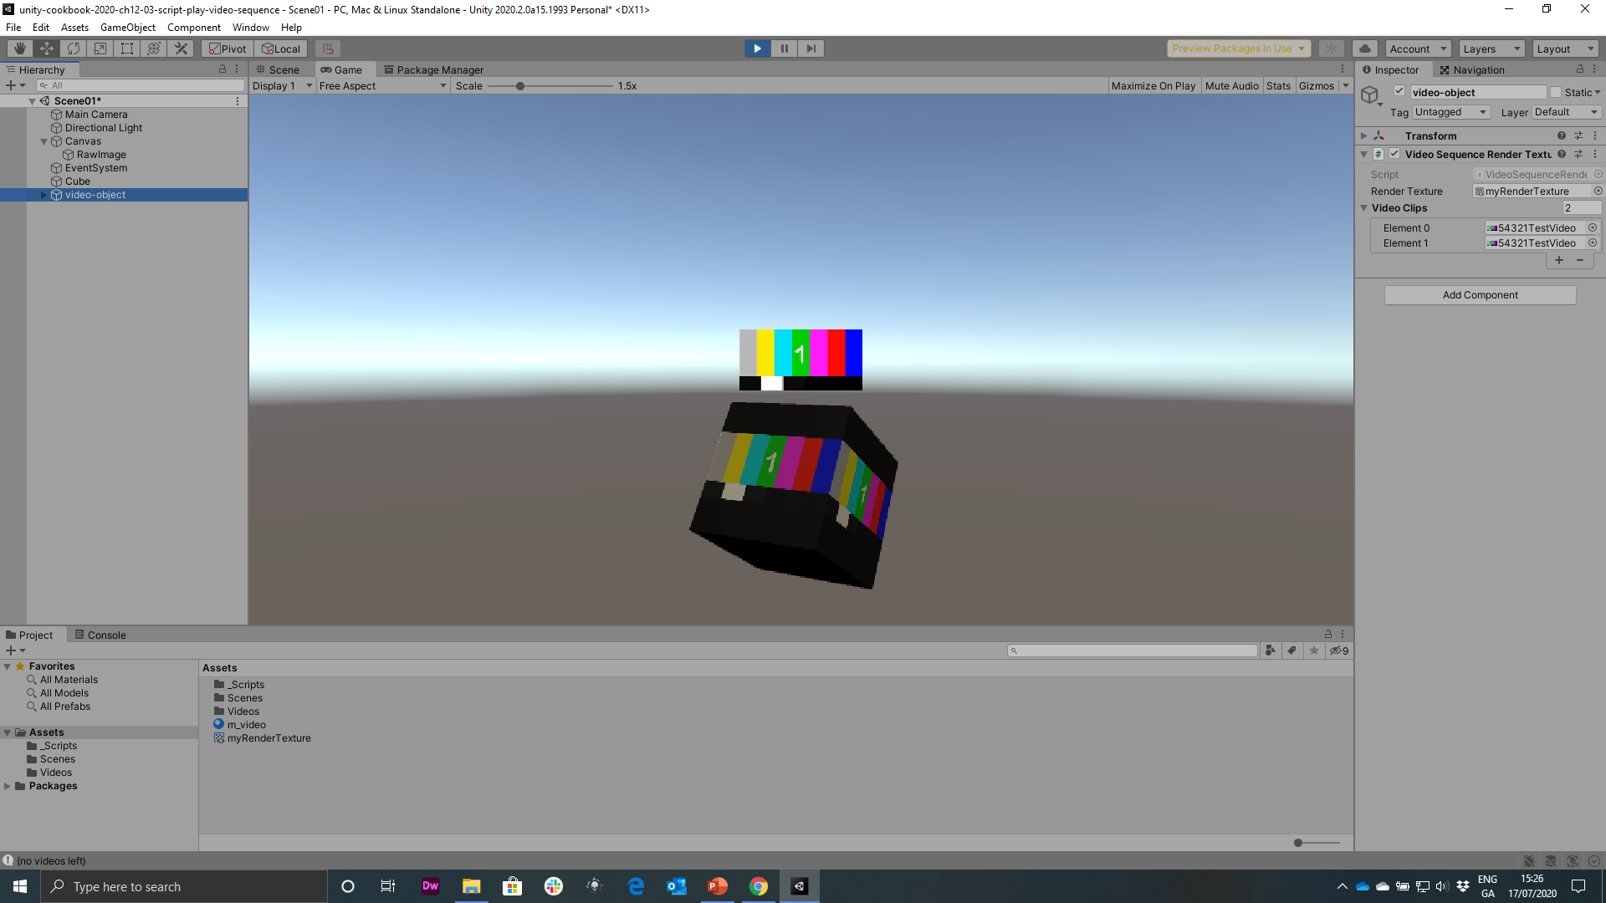
new
Figure 12.5: Settings for Video Sequence Render Texture of the video-object

Slide 6
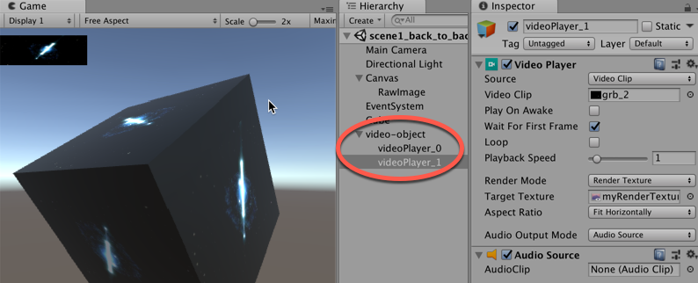
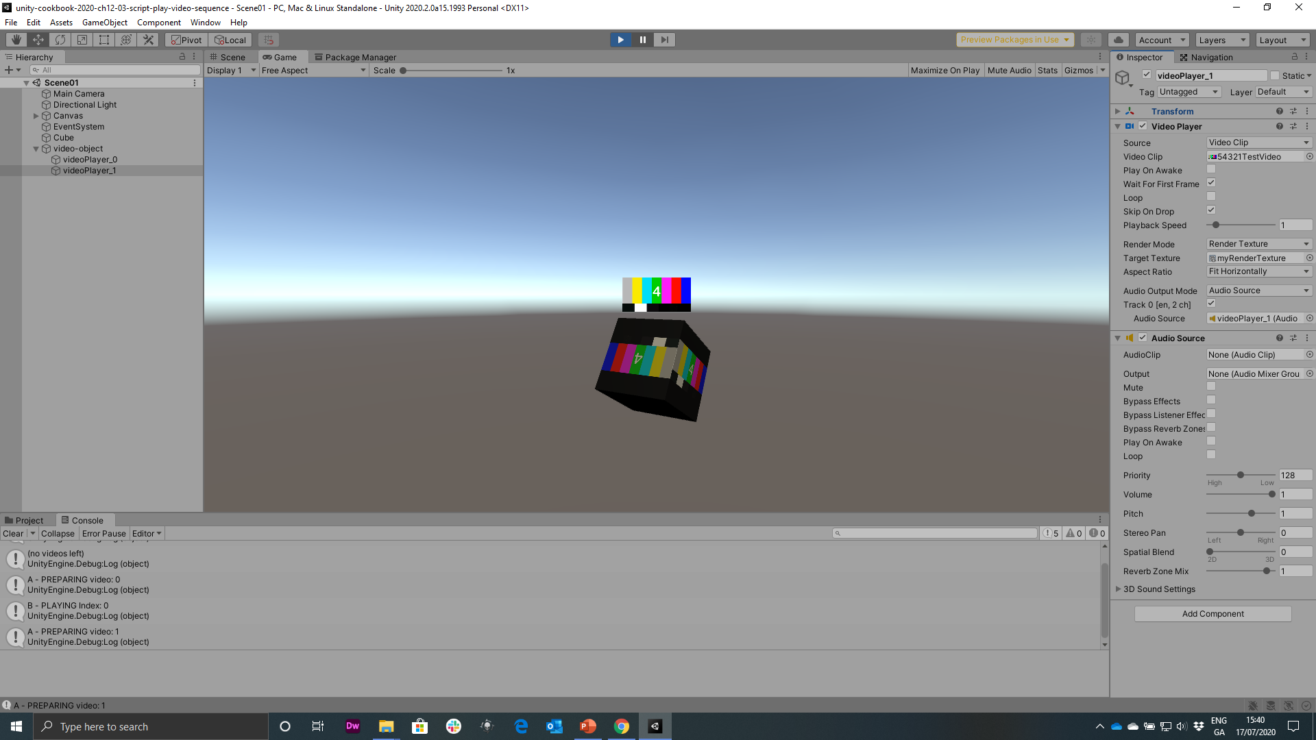
Figure 12.6: example highlighting the child elements at runtime, one for each element in the array

Slide 7
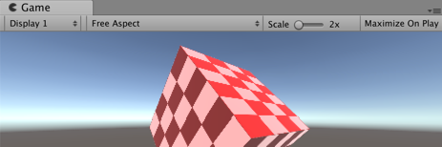
Figure 12.6: Example of the recipe, a checkerboard pattern applied to a 3Dcube

Slide 8
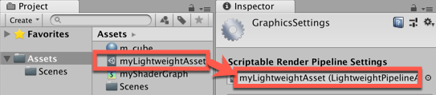
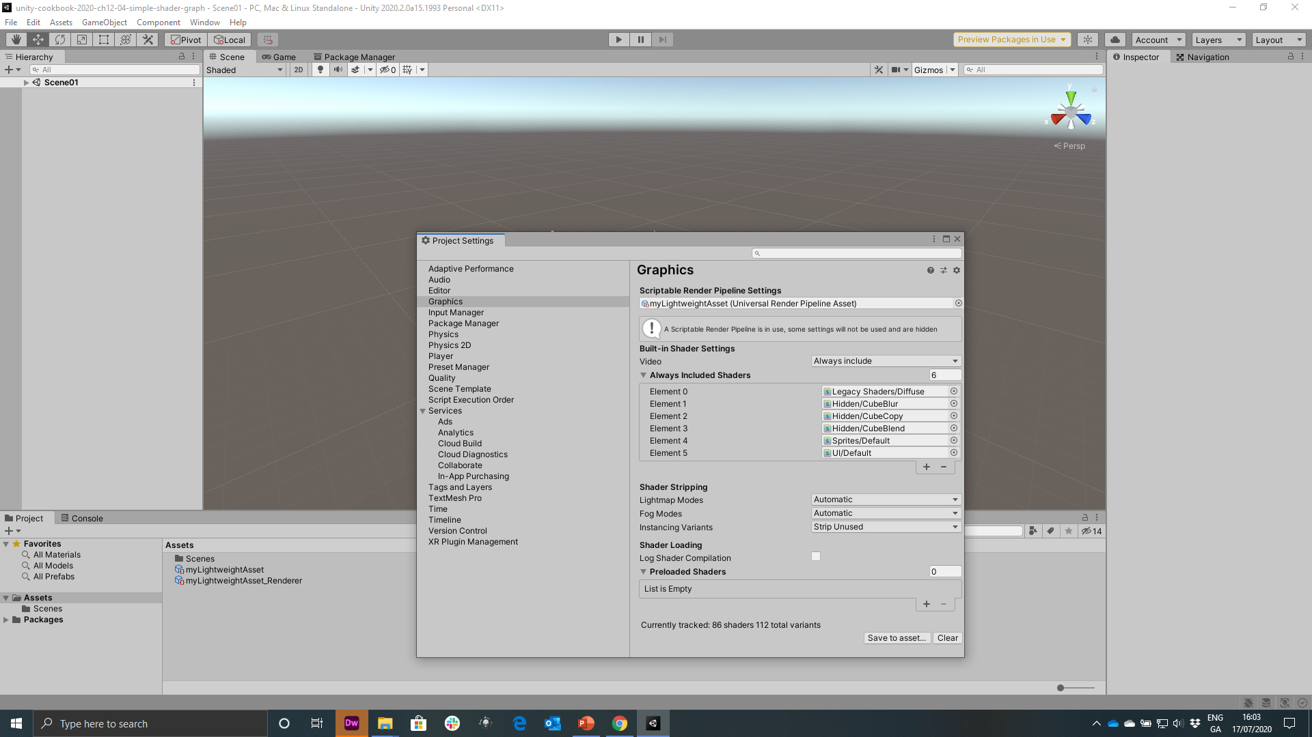
Figure 12.7: Dragging myLightweightAsset into the Scriptable Render Pipeline Settings

Slide 9
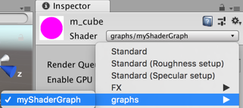
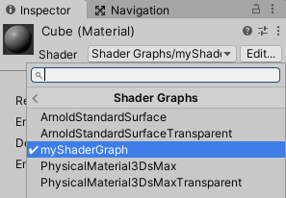
Figure 12.8: Setting m_cube's Shader property to myShaderGraph

Slide 10
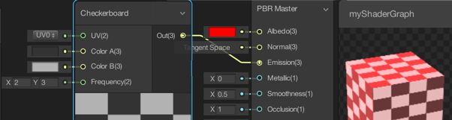
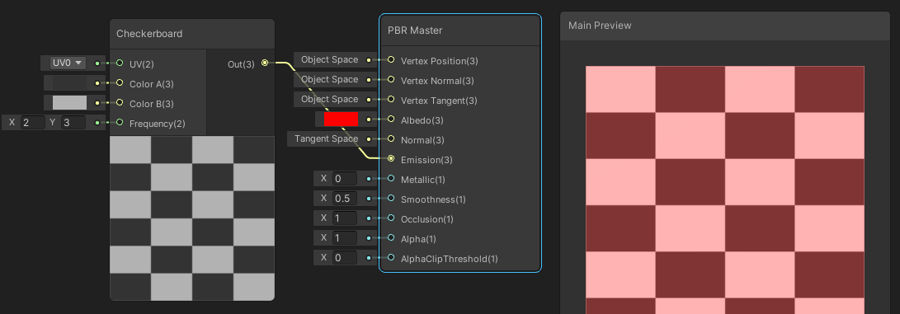
Figure 12.11: Linking from the checkerboard note output Out(3), to the Emission (3) input for the PRB Master node

Slide 11
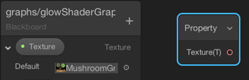
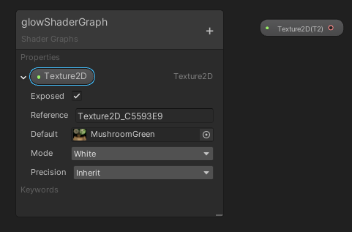
Figure 12.14: Dragging the Blackboard property Texture to create a new node

Slide 12
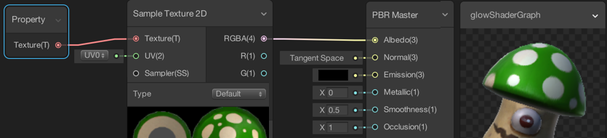
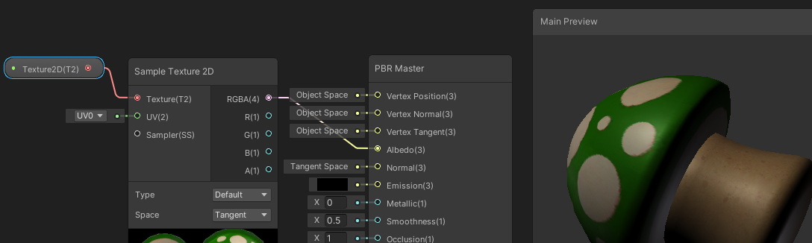
Figure 12.15: Shader Graph showing connections between the texture and PBR master

Slide 13
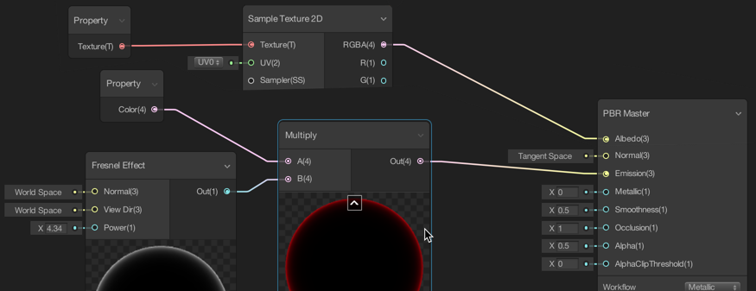
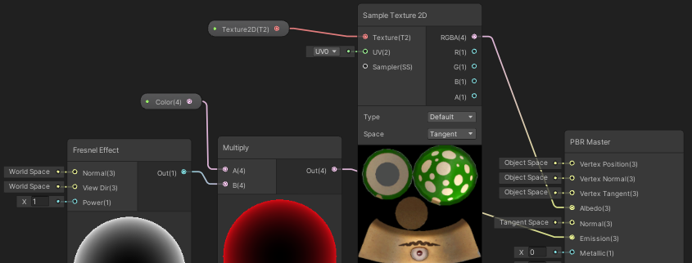
Figure 12.16: Final Shader Graph with connections for glow effect

Slide 14
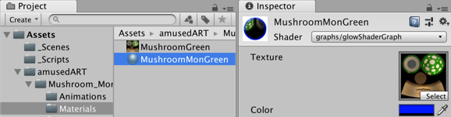
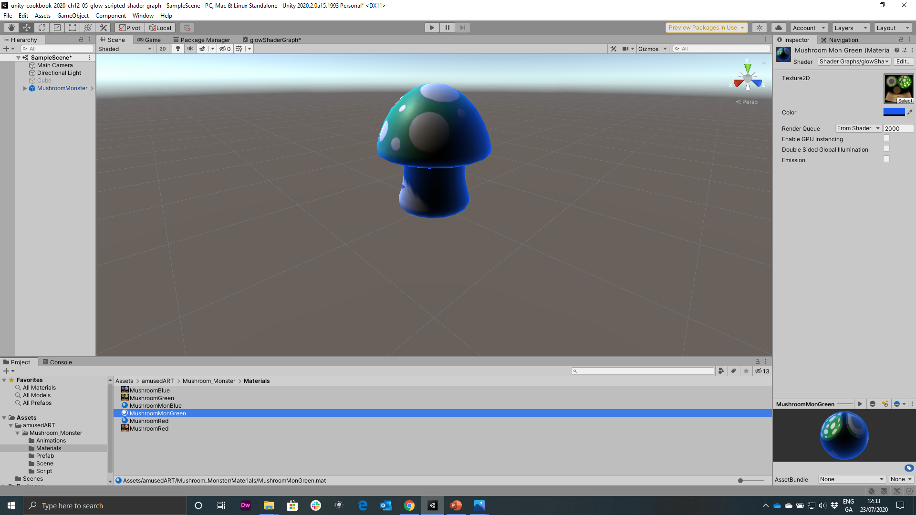
Figure 12.17 Adjustment of the Color property to blue using the color picker

Slide 15
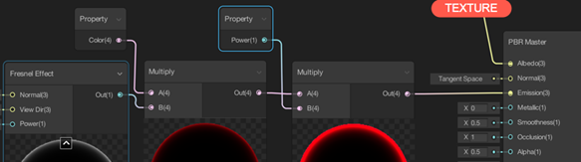
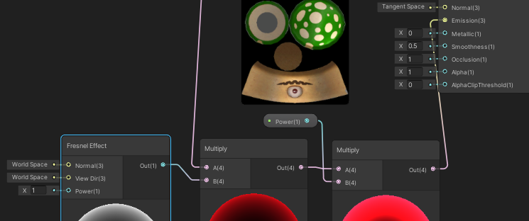
Figure 12.18: Settings of the ShaderGraph with additional multiply node

Slide 16
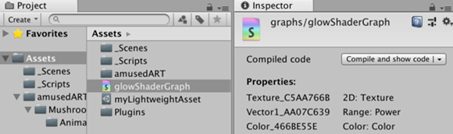
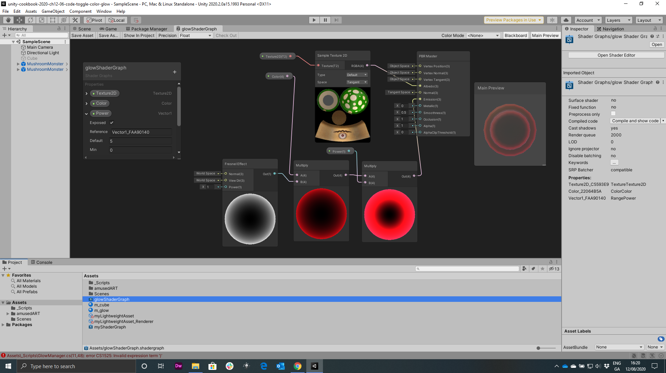
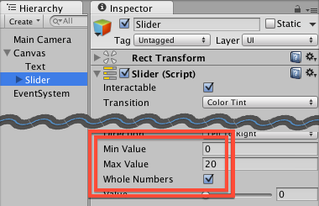
Figure 12.19: The glowShaderGraph properties via the Inspector

Slide 17
